Slide 1
True cases - Problem 1
A young Female Internee Medical Officer in the ward complains that the Senior House Officer in the ward is making Sexual Advances.
She is already engaged to an Internee House Officer working in the same hospital.
She complains to the consultant in the ward about the Sexual Harassment.
The consultant advises to give a written complaint for action to be taken.
The father of the female doctor advises the daughter to somehow manage the next two months and get a transfer out of the ward.
IF YOU ARE THE FEMALE INTERN HO WHAT WILL U DO?
Notes:
COMMUNICATION

Slide 2
True cases – Problem 2
In a small hospital in the district, the only midwife in the hospital is resident in the hospital.
She needs money for an exam she wanted to take for promotion.
The MO from a far away town gives the loan.
They become friendly …. Fall in love…. She becomes pregnant……’Boy friend’ rejects marriage….She feels ashamed….Commits Suicide.
WHAT WOULD HAVE BEEN YOUR ADVICE?
Notes:
YOUR FUTURE IS YOUR DECISION. BE BOLD TO MAKE THE RIGHT DECISION

Slide 3
True cases – Problem 3
A young 15 year old mother gives birth to a baby in your ward.
She had eloped with the ‘lover’ one year back.
What are the social problems she could face?
What suggestions can you give?
What ethical responsibility do you have in this case?
Notes:
KNOWLEDGE OF SOCIOLOGY. REPRODUCTIVE HEALTH AND RELATED LAWS. CRIMINAL ACTS.

Slide 4
True Cases – Problem 4
A Medical Professor’s close friend visits him to say that his daughter is getting married to a rich smart man from a well known family.
Professor inquires about the groom.
On hearing the details, Prof. tells the friend to stop the marriage immediately.
He says the groom is his patient.
That he suffers from HIV infection.
Marriage is cancelled.
Groom files legal action in Delhi Courts.
HAS THE PROFESSOR BROKEN THE CODE OF ETHICS IN MEDICAL BEHAVIOUR ?
Notes:
PATIENT CONFIDENTIALITY AND WHEN TOBE ‘BROKEN’.

Slide 5
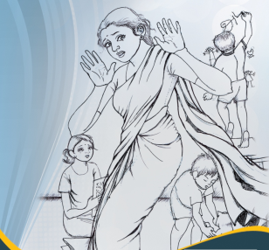
STOP GBV
Notes:
RIGHT TO LIVE SAFE. GENDER BASED VIOLENCE. NEED FOR CHANGE! PROSTITUTION WHO IS RESPONSIBLE?

